Slide 1
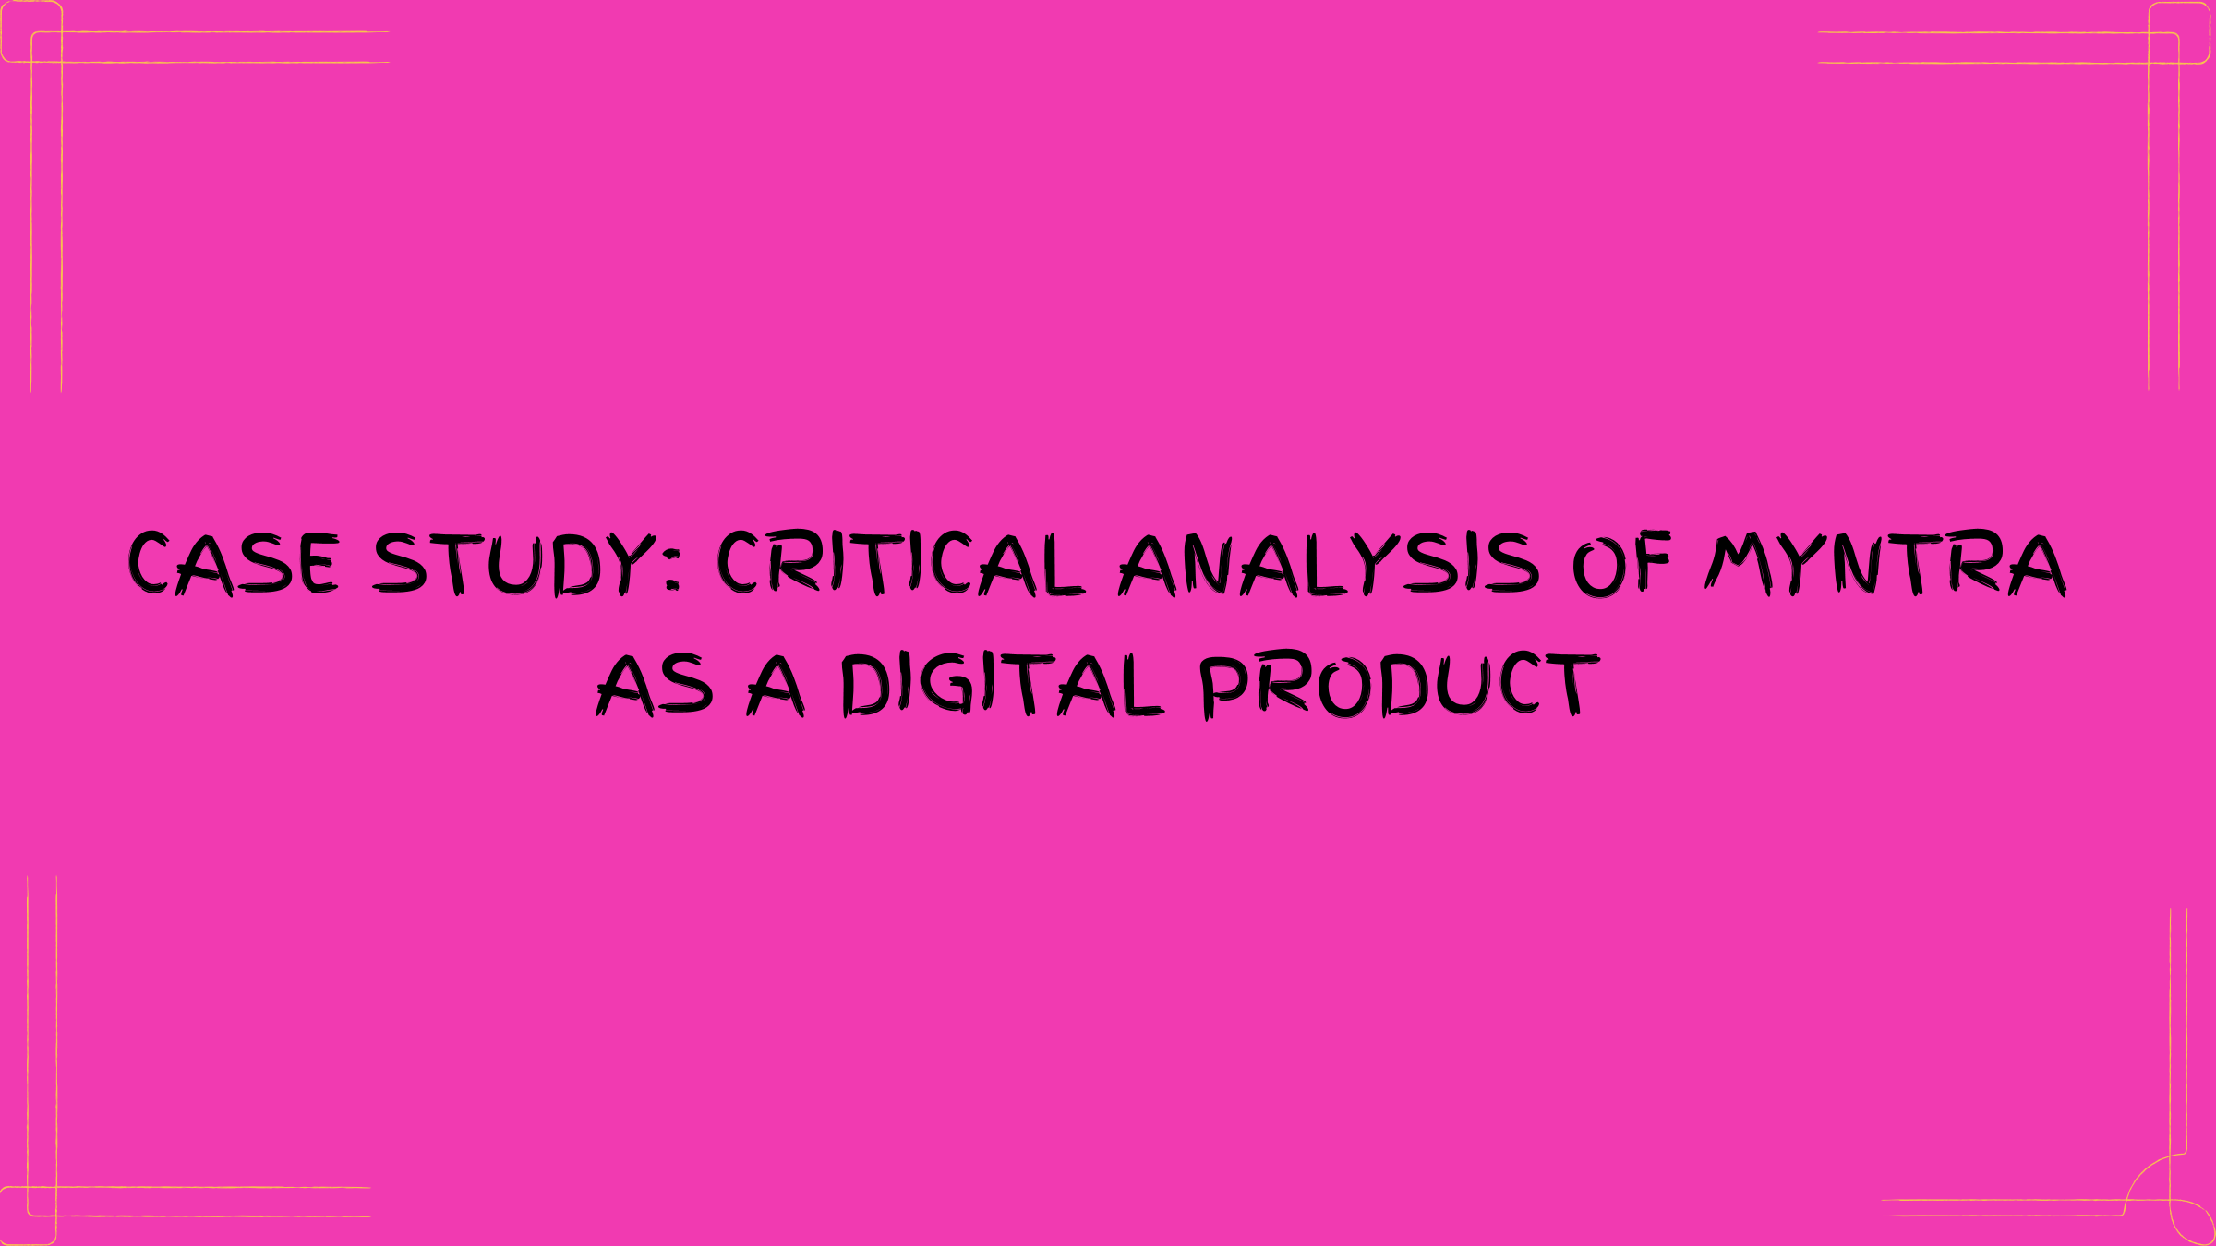

Slide 2
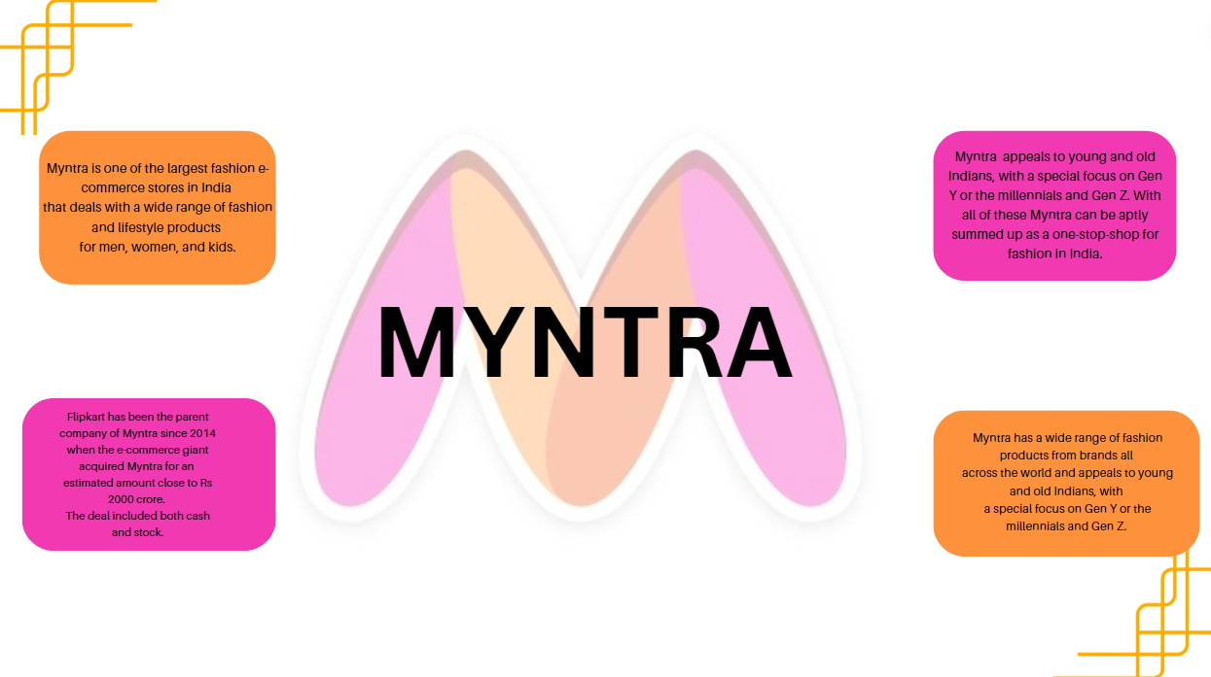

Slide 3
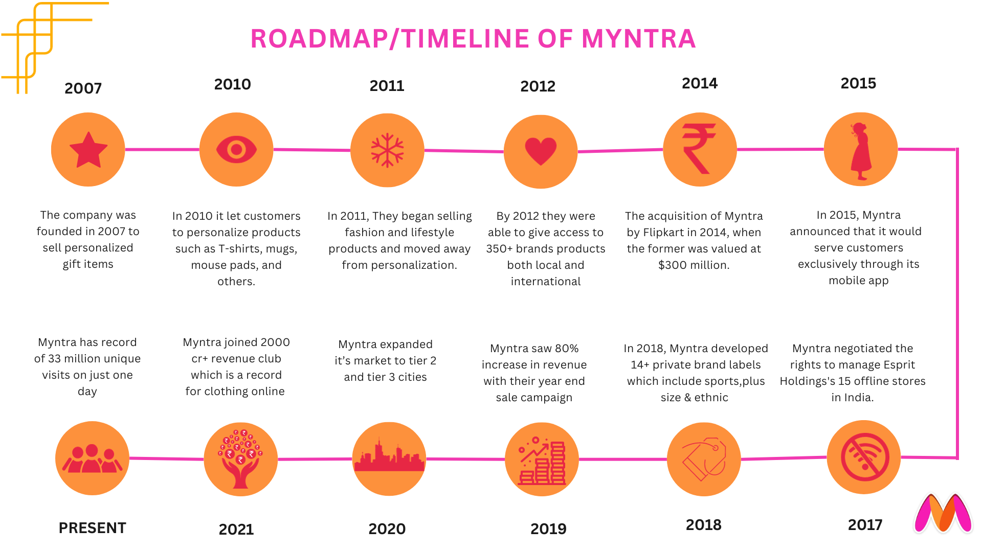


Slide 4
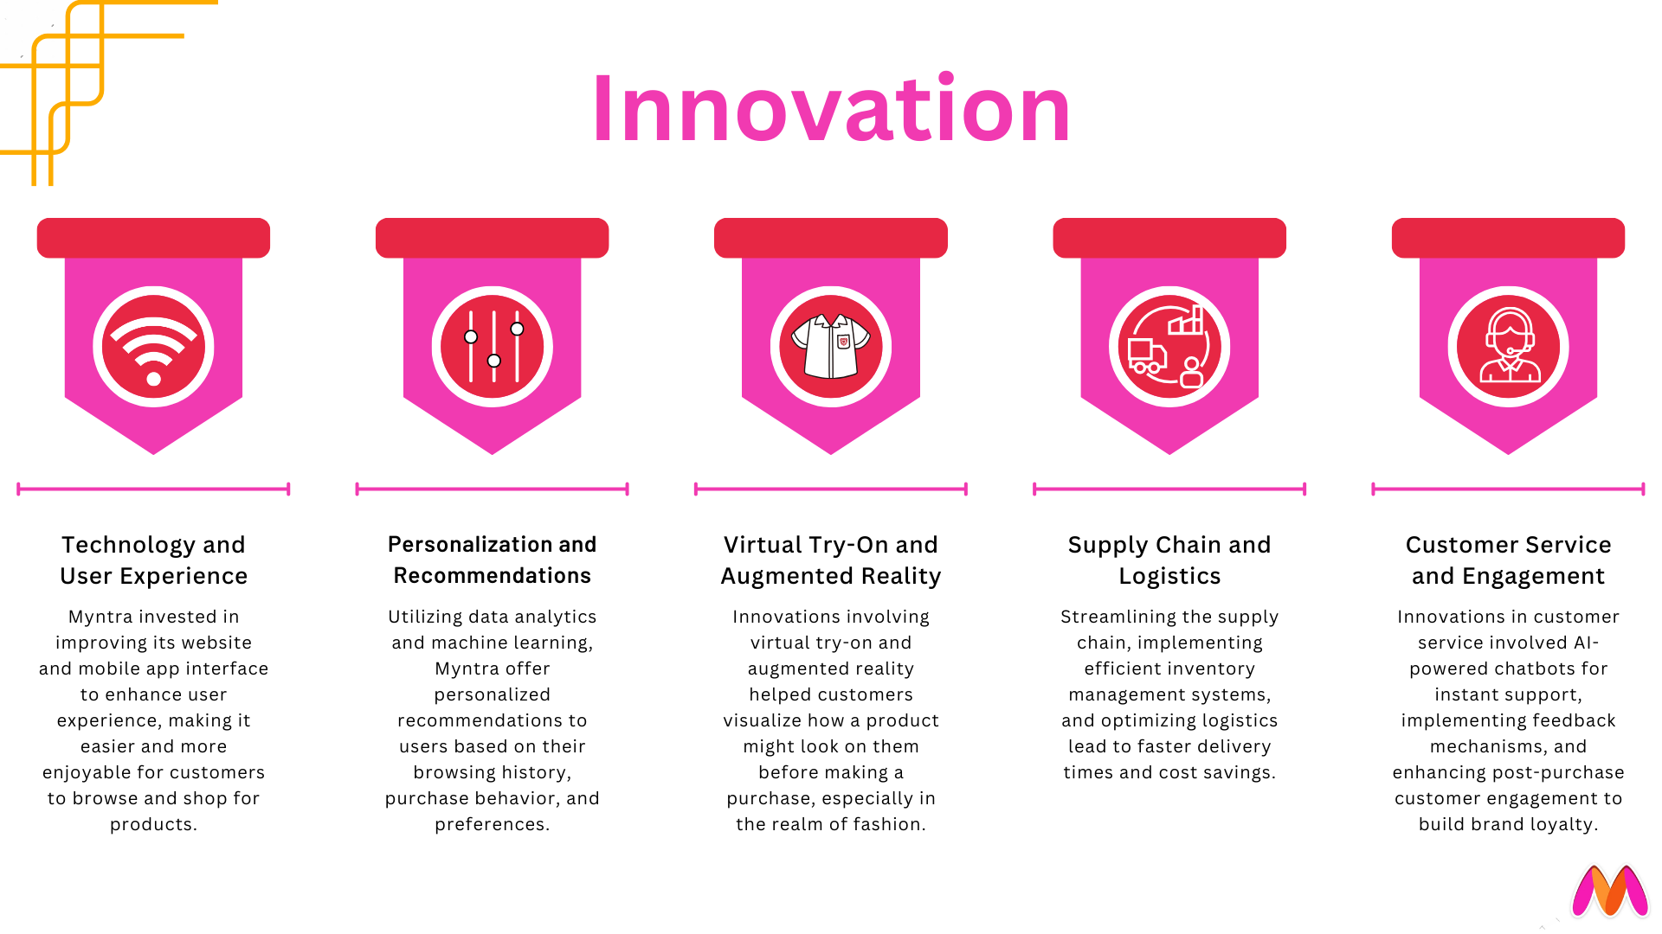

Slide 5
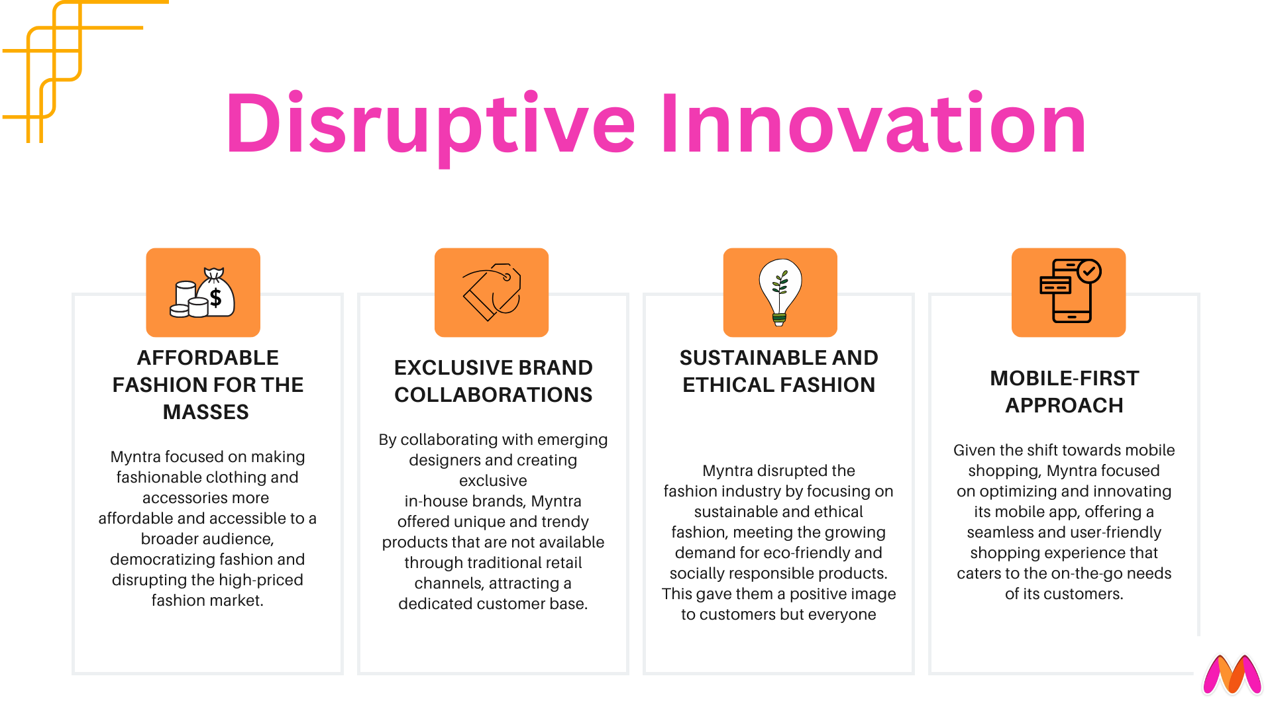

Slide 6
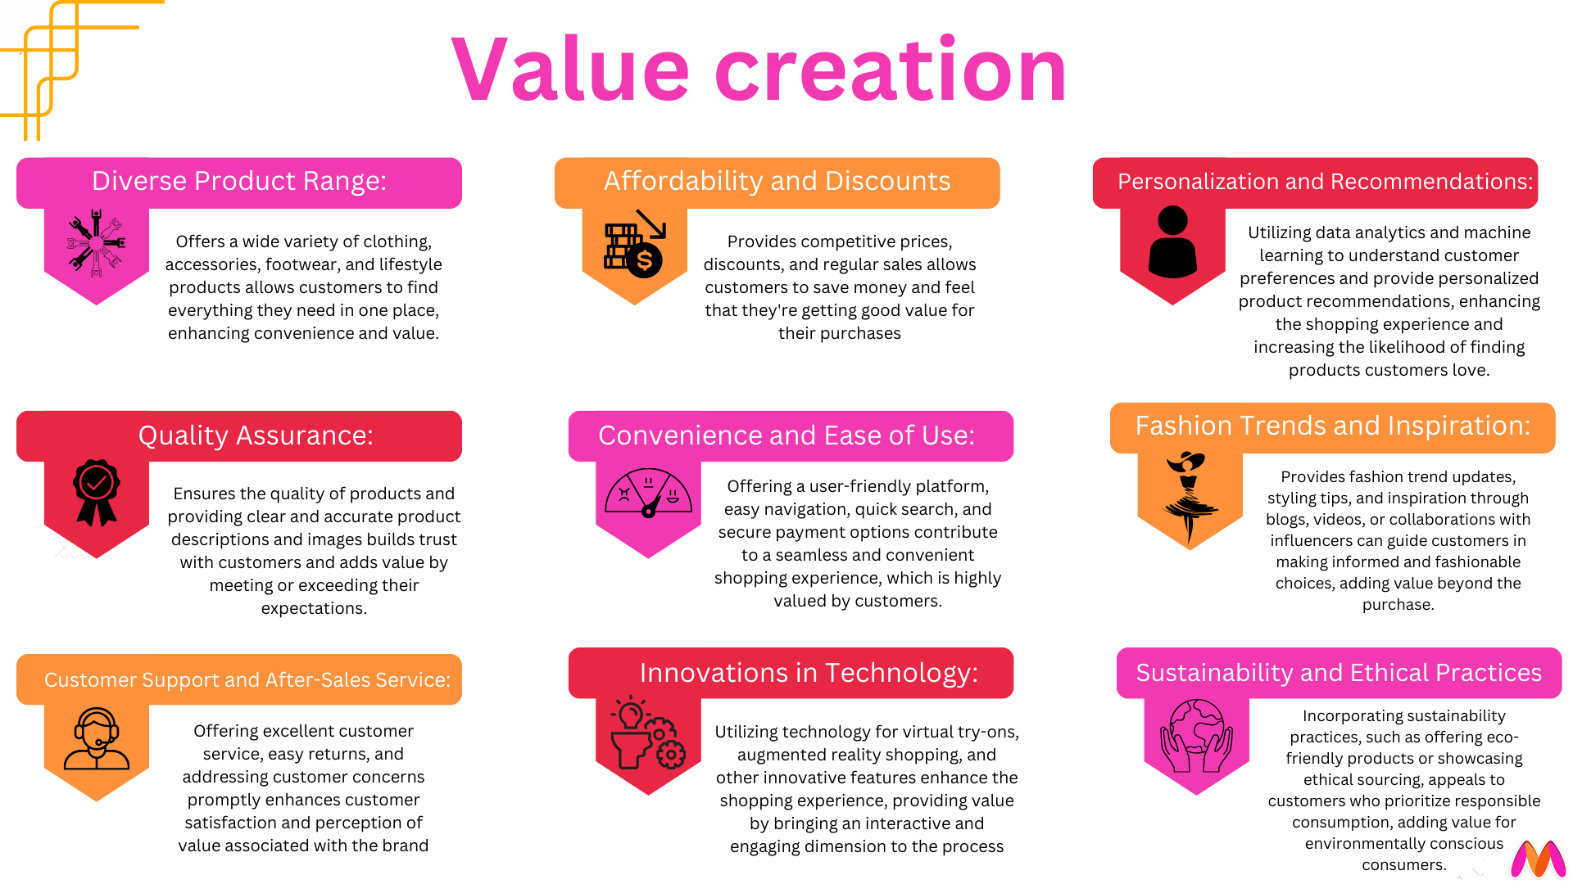

Slide 7
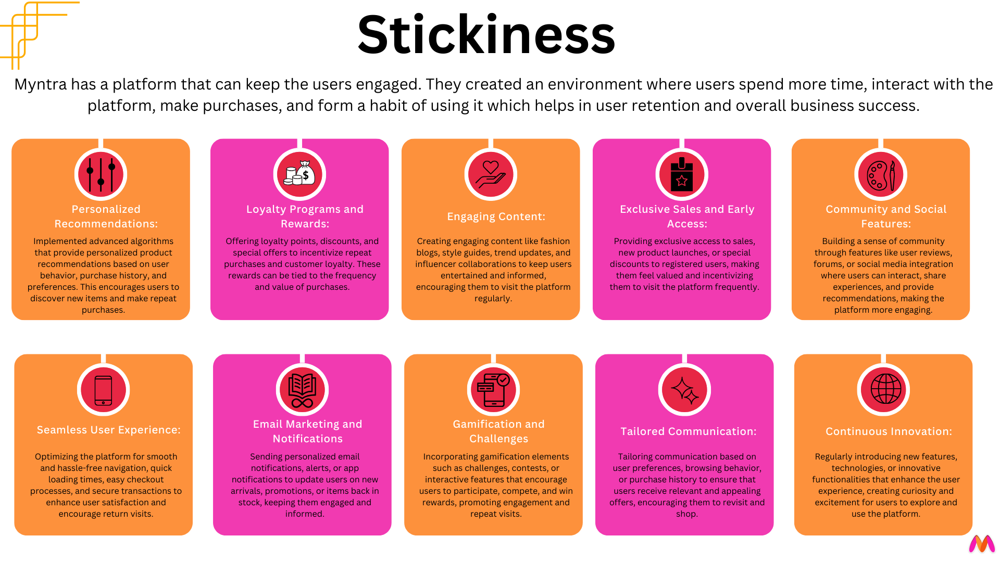

Slide 8
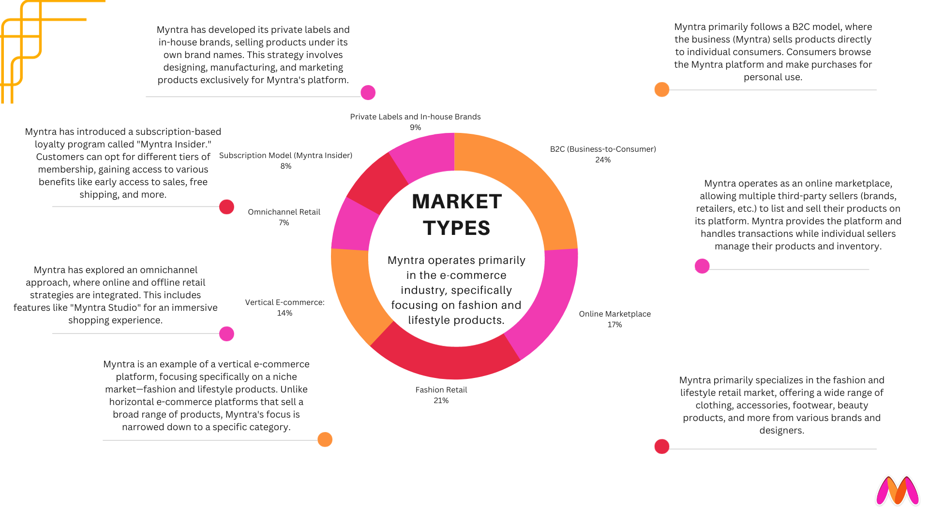
Myntra can explore entering international markets to tap into a global customer base. Targeting countries with a strong interest in Indian fashion and a growing e-commerce market could be a strategic move.

Slide 9
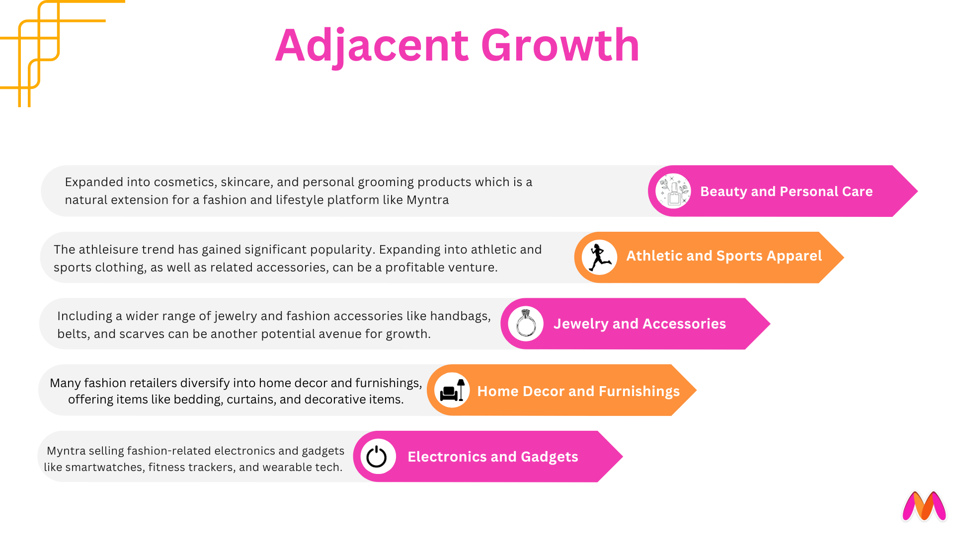

Slide 10
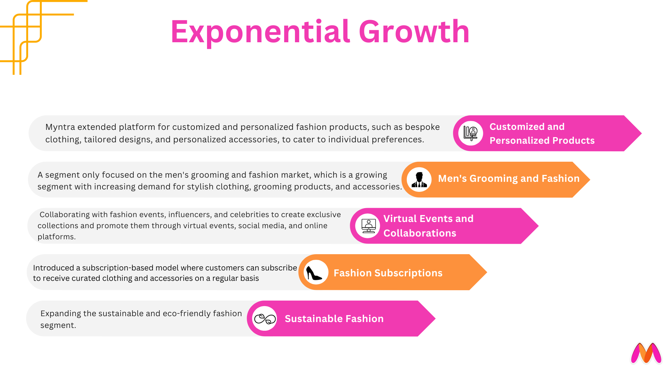

Slide 11
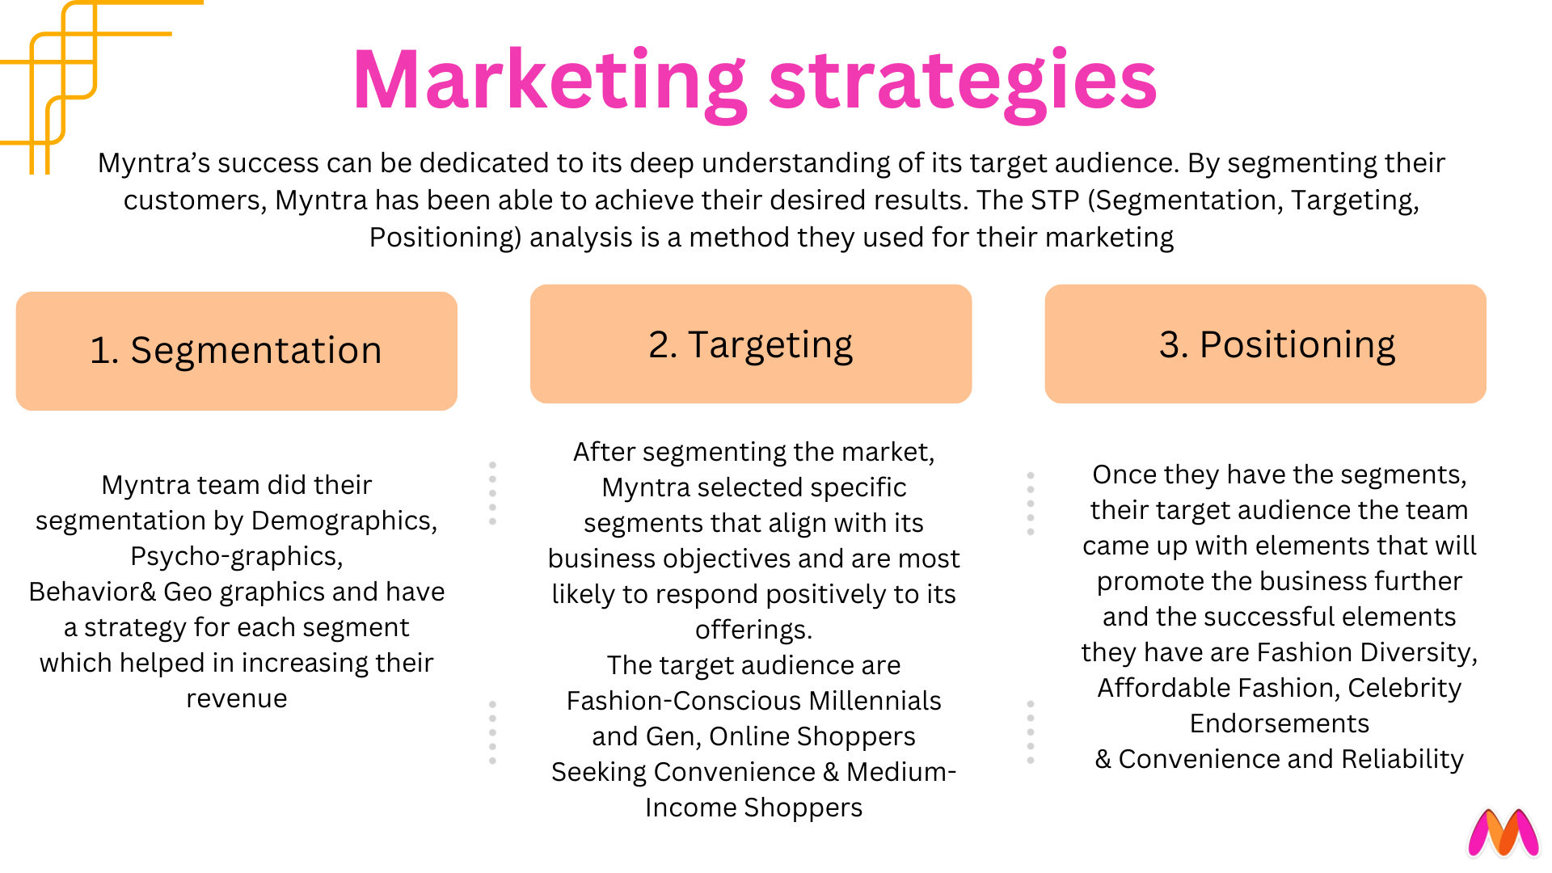

Slide 12
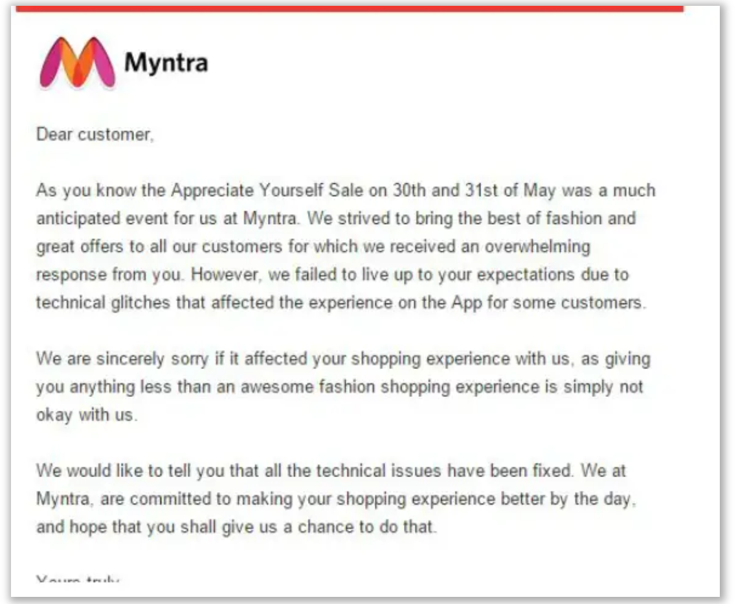
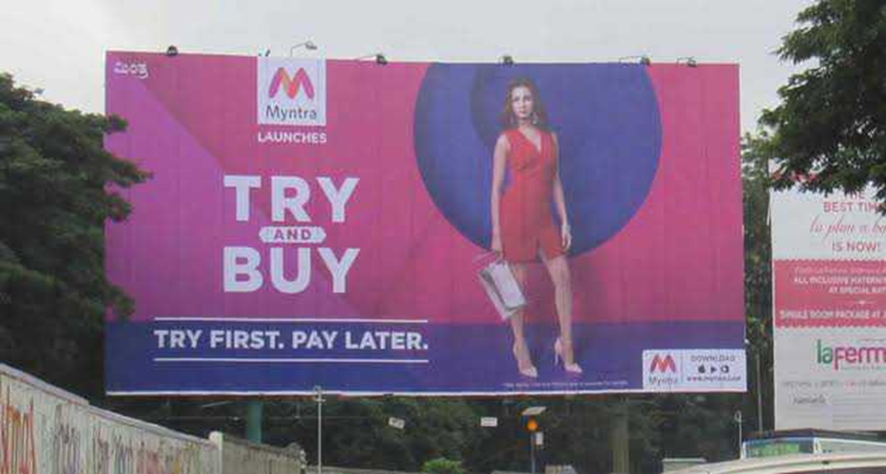
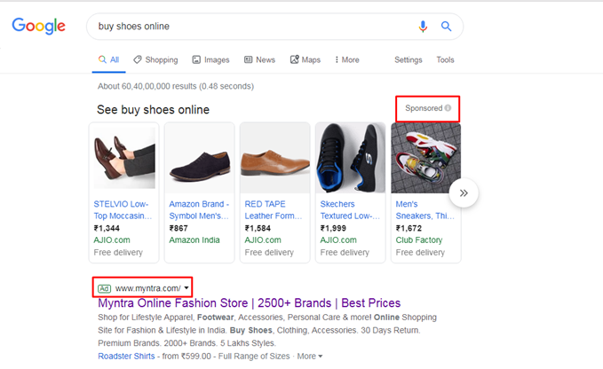
Promotions Offline Ads
Online Ads

Slide 13
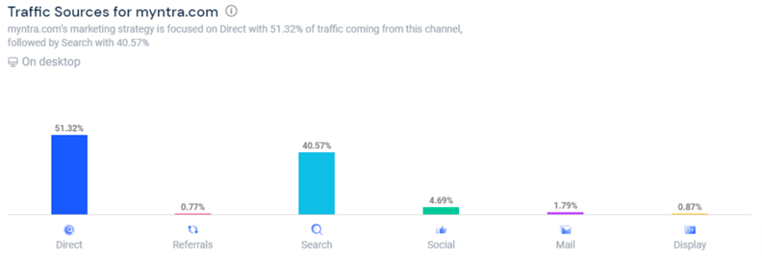
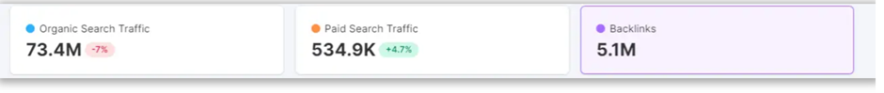
MYNTRA’s SEO & SEM
Now, this is a strong one because 40.57% of the traffic that Myntra gets is from online searches. From the 40.57% of its search traffic, 80.02% comes from its search engine optimization strategy, and 19.98% of search traffic comes from paid advertisements.

Slide 14
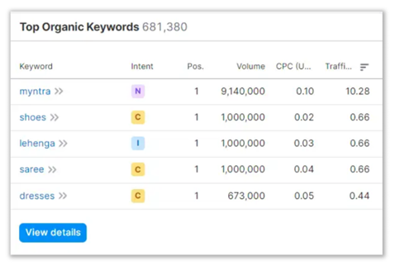
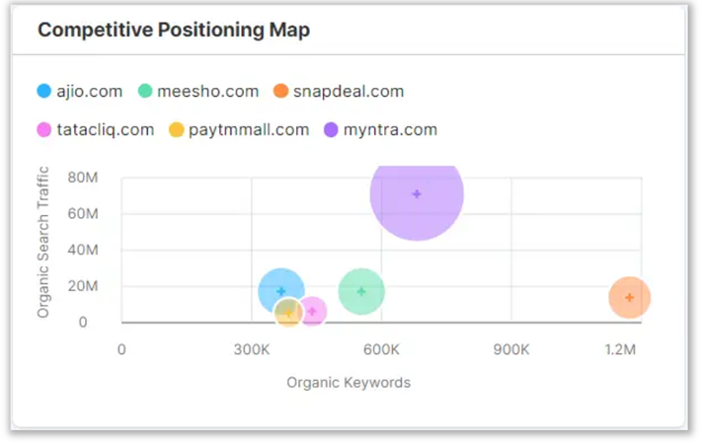
Myntra vs Competitors
Organic Keywords

Slide 15
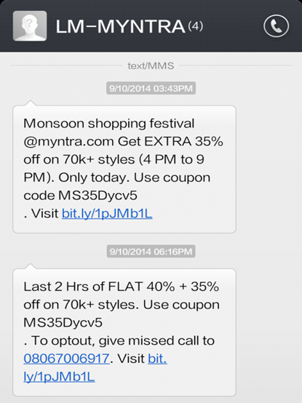
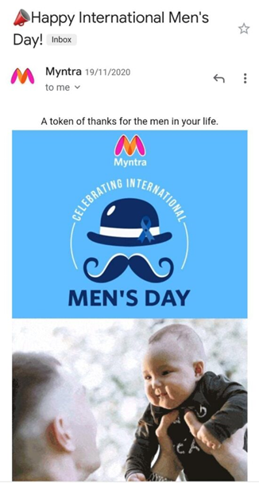
SMS Marketing
Email Marketing
Myntra’s SMS marketing in two words is “Short and Sweet.” If you are sending an SMS, it has to be short and still convey the point. Myntra’s SMS usually consist of short phrases like
“Saturdays are for relaxing and shopping.”
“It’s on the house! Buy 1, get 2 Free.”
“Oh no, Summer Sale ends at midnight.”
Myntra uses its email marketing campaigns to make its existing customers buy from the platform. Also, Myntra notifies the customers about a sale, discount, or offers on specific brands. Also, Myntra creates fear of missing out (FOMO) with their email subject lines so that the customer makes an impulse purchase.

Slide 16
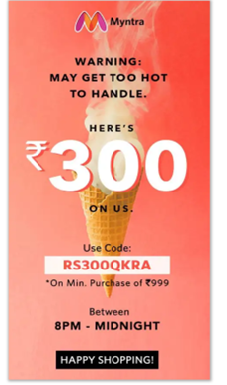
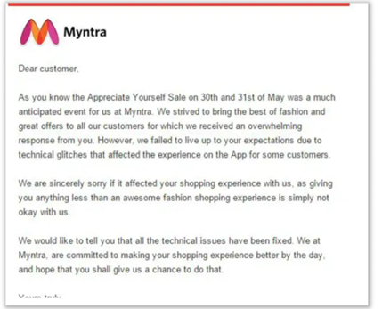
Myntra’s email & mobile marketing strategies are based on position & timing also highly personalized

Slide 17
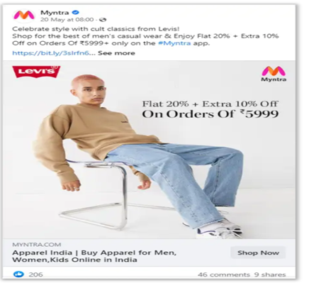
MYNTRA’S SOCIAL MEDIA PRESENCE
Facebook:
Myntra’s early facebook strategy was all about growing its fan base & ran several competitions & campaigns that encouraged users to like its page. Initially it grew it’s fan base from 100K to 10 million in 2 years.As a result it avg. more than 100K interactions per month by 2016 .

Slide 18
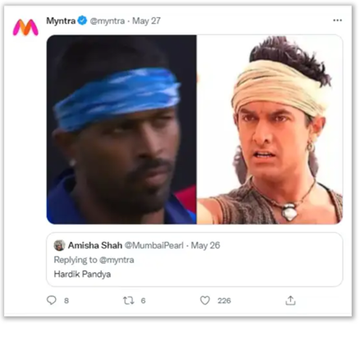
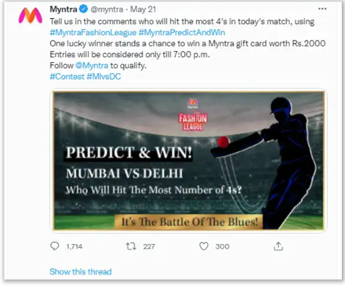
2) Twitter:
Myntra’s twitter engaged with it’s customers

Slide 19
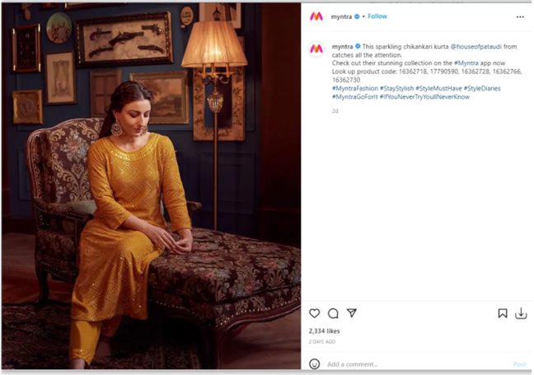
3) Instagram:
Myntra collaborates with micro-influencers having 10K to 50K followers on Instagram. On Myntra’s Instagram page, they share posts by such micro-influencers.

Slide 20
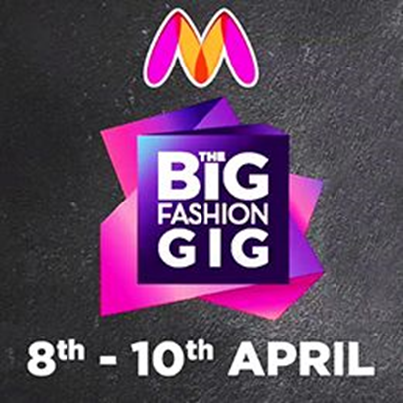
MYNTRA’S MARKETING CAMPAIGN
Big Fashion Gig(2015)
This campaign was run by Myntra in 2015 & was a grand success. To do this Myntra collaborated with several celebrities & fashion bloggers to create videos promoting the benefits of shopping online. As a result it increased in traffic to Myntra’s website & app. The aim was to get fresh perspectives on fashion & trends from the Indian creative community.

Slide 21
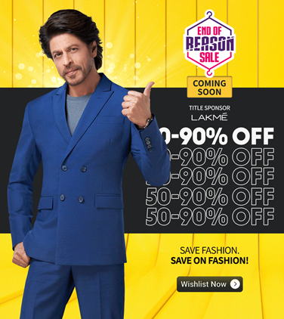
2) Myntra End of Reason Sale : 15th edition ‘Ab har koi reason chalega’(2022)
Myntra has started a marketing campaign. “Ab Har Koi Reason Chalega!” is the catchphrase for the advertising campaign. The Myntra End of Reason Sale was a huge success with over 10 million products sold throughout the 10-day scale. This was a 50 % increase in sale compared to the previous year due to massive discounts & deals.The importance of a good marketing campaign(Alia Bhatt,Ranveer Singh),good logistics partner(ekart),good customer data,post sale strategy,a good team.

Slide 22
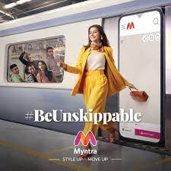
3) #BeUnskippable(2019)
This was when they wanted to be popular in mobile platform as well.Myntra announced the launch of #BeUnskippable, a new brand initiative that emphasizes its position as a go-to resource for fashion for its clients.
What did Myntra do?
Myntra launched a series of short, unskippable ads on Youtube.The ads were designed to be viewed on devices & featured various fashion items available on Myntra. The ads also accompanied by a catchy soundtrack,making them even more difficult to skip.This ad campaign titled “UnSkippable” was launched in Tamil, Telugu, Kannada, and Hindi. It was hugely successful with over 14 million views & a 97% view through rate which resulted to increase in traffic on Myntra.

Slide 23
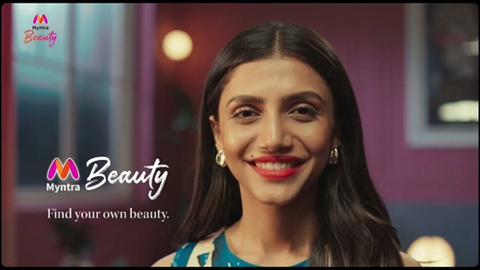
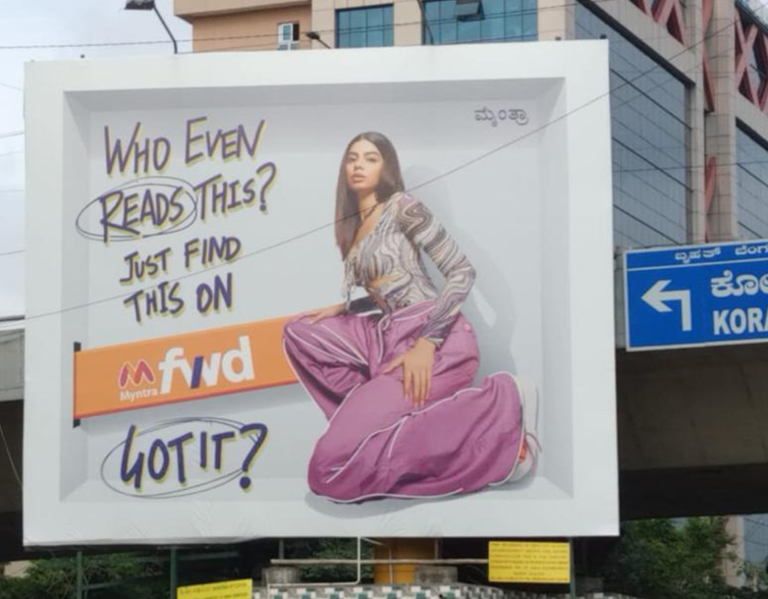
Find your own beauty: Launched with respect to Myntra Beauty Line.
Myntra FWD: Targeting Gen-Z consumers #SpotItGetIt in collab with Idea Fams

Slide 24
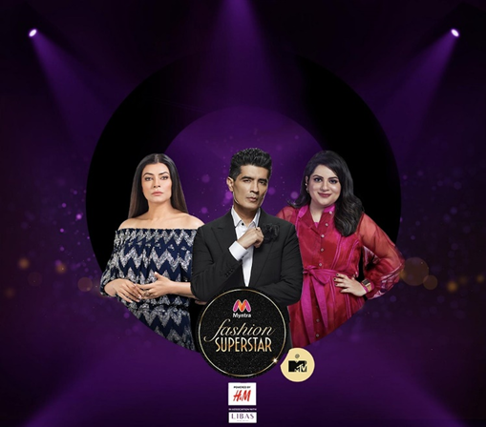
MYNTRA FASHION SUPERSTAR
Myntra recently launched a digital reality show for influencers. The title of the show is “Myntra Fashion Superstar” to hunt for fashion influencers on its shopping platform. The show featured famous celebrity judges industry like Sushmita Sen and Manish Malhotra. It was a show that gained popularity because of its different theme to hunt for influencers. It gave a platform to influencers to present their style and create a fashion statement.

Slide 25
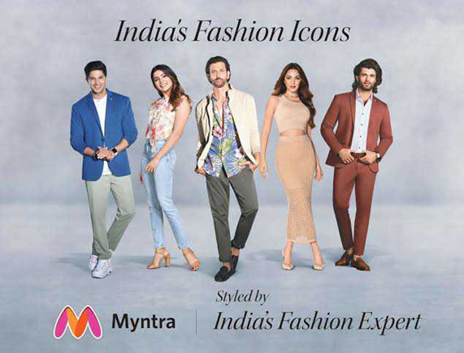
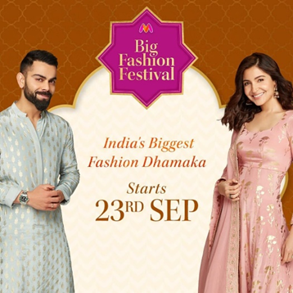
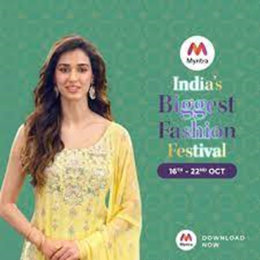
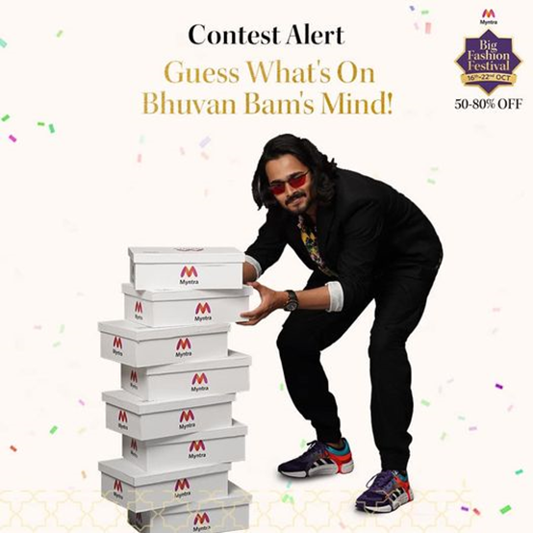
MYNTRA’S AMBASSADORS
Bhuvan Bam Youtuber(digital brand ambassador)
Hrithik Roshan,Vijay Deverakonda, and Dulquer Salmaan, Kiara Advani and Samantha Ruth Prabhu (celebrity ambassador)
Anushka and Virat Kohli (Myntra's first official Ambassadors)
Disha Patani (Myntra's first Beauty Brand Ambassador).

Slide 26
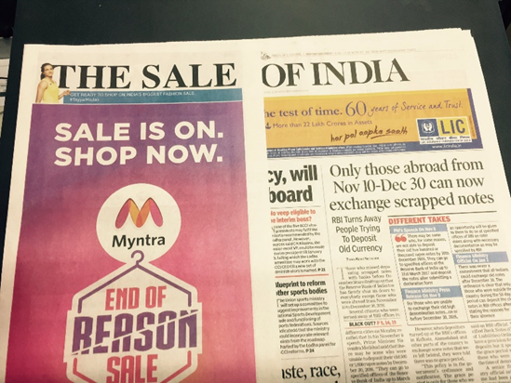
MYNTRA IN NEWSPAPERS

Slide 27
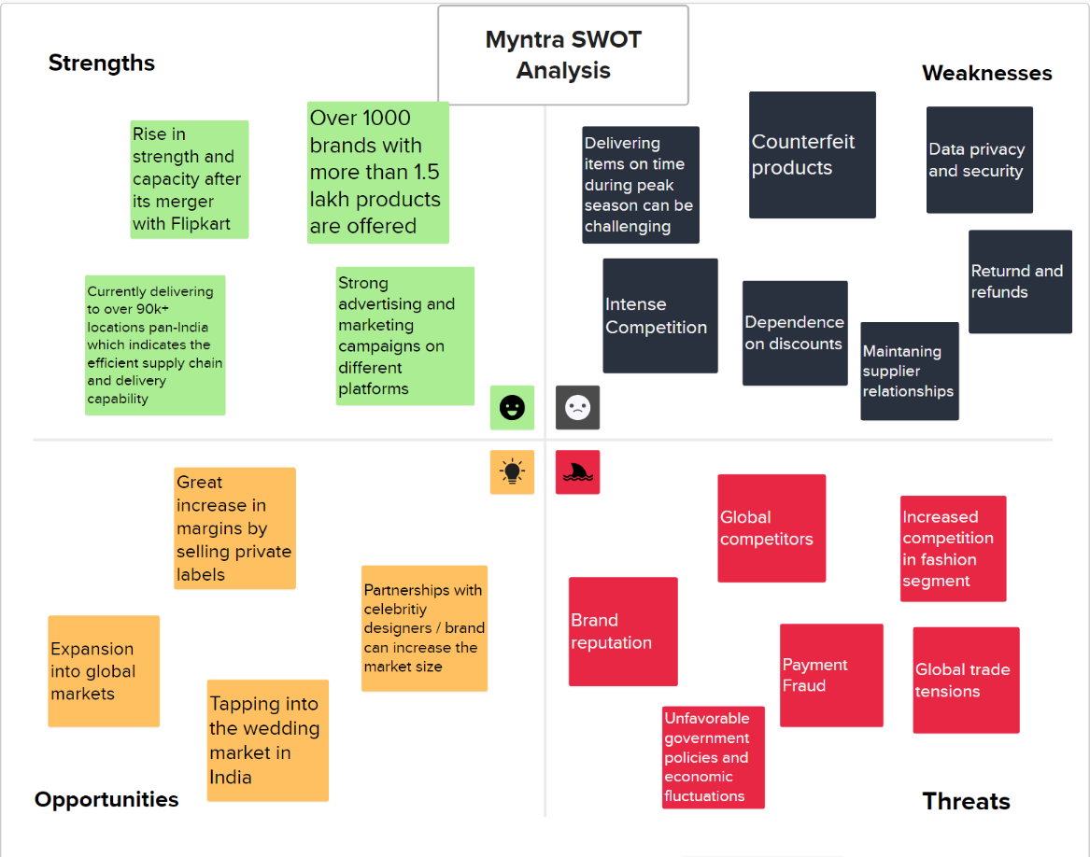

Slide 28

Thank You!

